Slide 1

Digital Steganography
Guided By: Archana Lopes
Presented By:
Rutik Yerunkar (8851)
Sushant Shanbhag (8837)

Slide 2
Description Of The Project:
Some messages are to be encrypted but as hacking grows ,maintaining secrecy is getting tougher. Thus our project Digital Steganography aims to overcome this factor by using multimedia data which could be sent to desired users with less risk of being hacked.
Cyber Security is big headache for people working in sensitive fields , we intend to develop a system in which one can hide secret data in form of images in which receiver has the access to the information provided he has the secret code .This image acts a transfer of information without attracting hackers as one can see only image not the information.

Slide 3
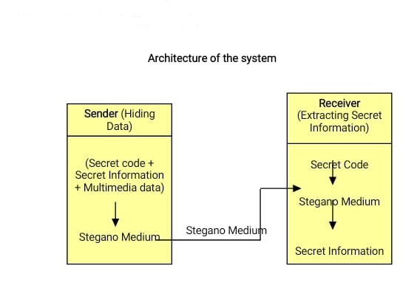
Architecture Of The System:

Slide 4
Class Diagram:
User
Hide()
Break()
Hide
Break
User Code
Secret Information
Picture
Stegano Medium
Secret Code
Secret Code
Stegano Medium
Secret Information
Break()
Hide()

Slide 5
Case Diagram:
Sender:
Loading Picture
Entering User Code
Entering Secret Information
Sender
Generating Secret Code
Creating Stegano Medium

Slide 6
Receiver:
Loading Stegano Medium
Entering Secret Code
Getting Secret Information

Slide 7
THANK YOU

